Slide 1

NEXTHIKES IT SOLUTIONS
PROJECT-5
Telecom User Behavior and Satisfaction Analysis
Exploratory, Engagement, Experience,
and Satisfaction Analysis
MAHAK GOYAL

Slide 2
Project Overview
Objective: Understand user behavior, engagement, experience, and satisfaction
Dataset: Telecom xDR session data
Tools: Python, Pandas, Sklearn, MySQL
Methods: EDA, Clustering, PCA, Regression

Slide 3
Task 1 - User Overview Analysis
Objective:To understand the devices most frequently used by customers for better targeting and support.
📱 Top 10 Handsets by Usage:
Identified based on the number of sessions and traffic.
Reflects the most popular devices among users.
🏭 Top 3 Manufacturers:
Ranked by the number of handsets in use.
Helps identify dominant market players.
📊 Top 5 Handsets per Top 3 Manufacturer:
Further granularity on brand-specific popularity.
Supports brand-level marketing and partnership decisions.

Slide 4
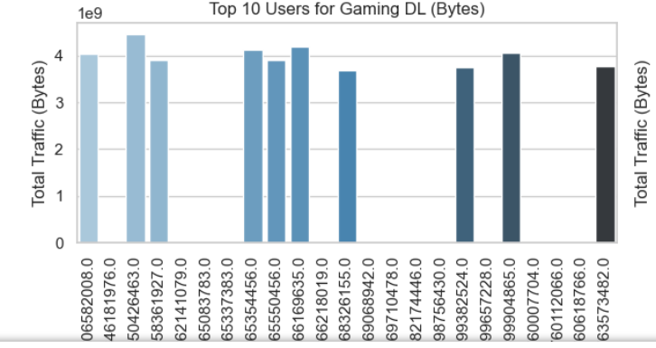
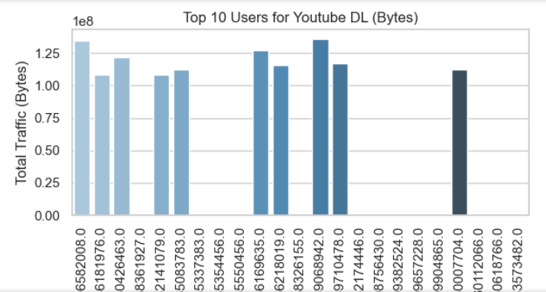
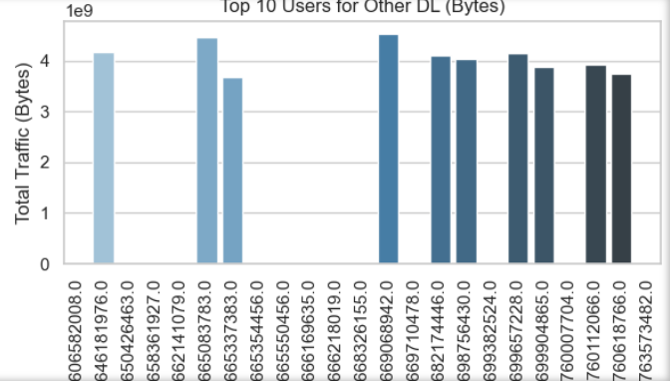
Handset Insights
Visualization:
Top 3 Applications:
Top 3 most used apps based on total data usage.
Bar plots showing top users for each of the top apps.

Slide 5
User Behavior Aggregation
Key Steps:
Data Aggregation:
Calculated session count, total duration, and total traffic per user.
App-Specific Traffic:
Total traffic (DL+UL) for each application tracked per user.
Metrics per User:
xDR Session Count:
Total number of data sessions per user (MSISDN).
Session Duration:
Total duration (in milliseconds) of all sessions per user.
Total DL + UL Traffic:
Sum of download and upload traffic (in Bytes) per user.
App-Specific Data Usage:
Data usage for each application (e.g., Social Media, Google, YouTube, etc.) per user.
Insights:
Helps understand overall user activity across sessions.
Identifies high-engagement users and applications for targeted marketing and resource allocation.

Slide 6
🔍 Data Cleaning:
Missing Values:
Replaced using mean imputation for numerical columns.
Outliers:
Detected using boxplots and handled by mean replacement to preserve data consistency.
Variable Types Summary:
Categorical Variables:
Handset Type, Manufacturer, Application Types
Numerical Variables:
Session Duration, Total DL/UL Traffic, App-specific Usage, RTT, TCP, Throughput
Objective:
To ensure data is clean, consistent, and ready for analysis and modeling.

Slide 7
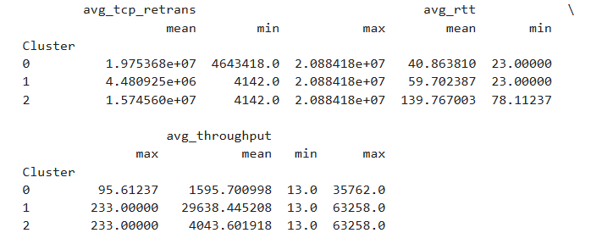
Descriptive Statistics
Importance:
Helps understand overall user behavior
Detects skewness or anomalies in user engagement
Aids in tailoring network services and marketing efforts based on actual usage patterns
Key Metrics Analyzed:
Session Frequency
Session Duration
Download + Upload Traffic
Application-wise Data Usage
Statistical Measures:
Mean: Average user behavior over the dataset
Median: Central tendency; reduces impact of outliers
Mode: Most common behavior or usage pattern

Slide 8
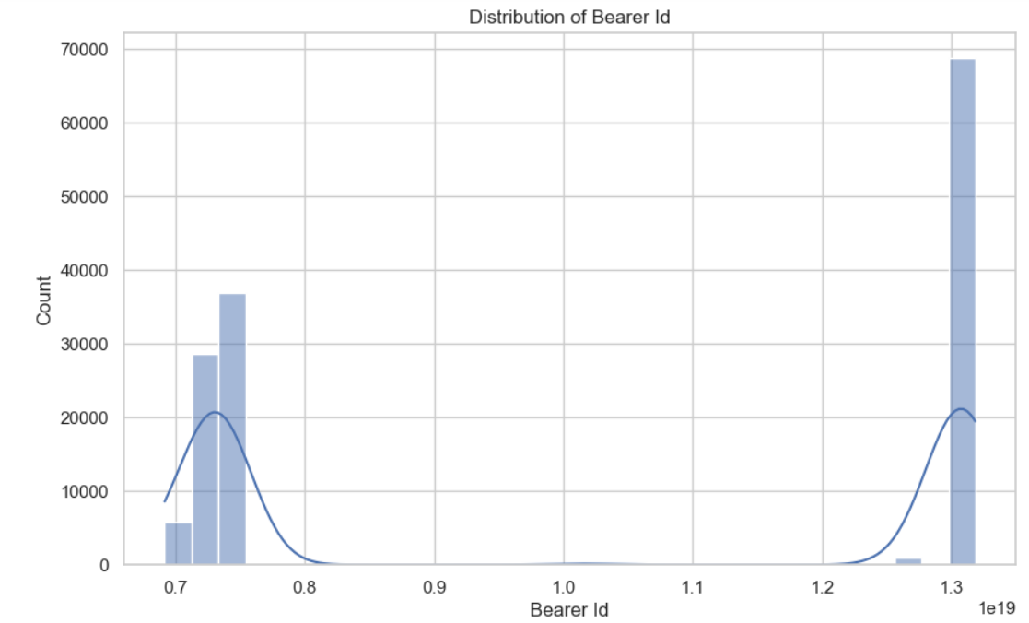
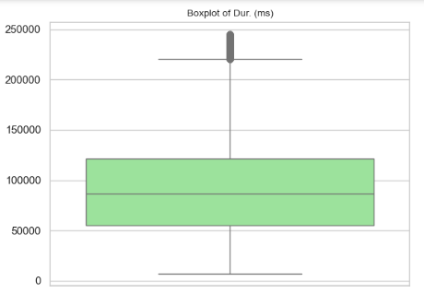
Univariate Analysis
Dispersion Measures:
Standard Deviation: Measures spread around the mean
Variance: Degree of spread in user behavior
Range: Difference between max and min values
Visualization Tools:
Histograms:
Identify data distribution for each metric
Detect skewness or uniformity
Boxplots:
Highlight outliers
Compare spread and central tendency

Slide 9
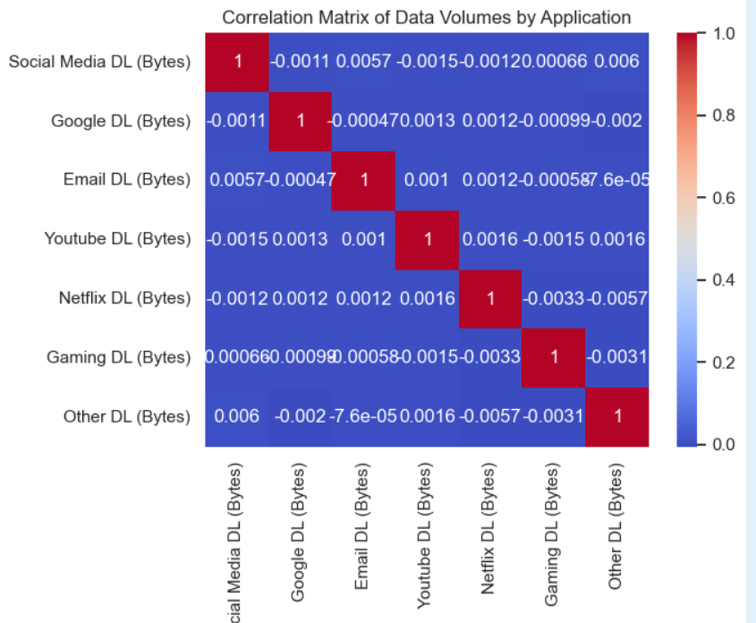
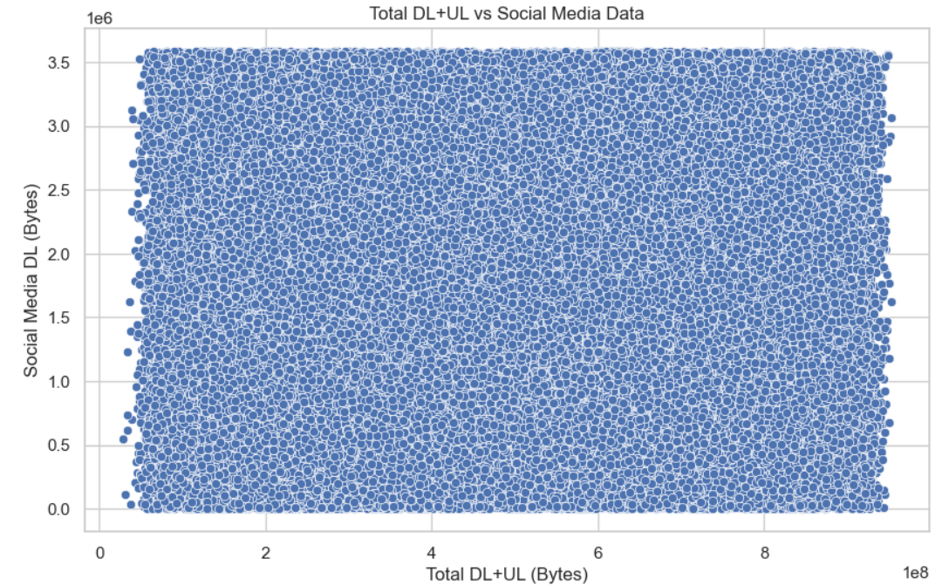
Bivariate Analysis
Correlation Analysis:
Assessed relationship between App-specific traffic and Total DL+UL traffic
Strong correlations suggest app usage significantly impacts total data usage
Visualizations:
Heatmap: Visualizes correlation matrix between all app traffic variables and total data
Pairplot: Shows pairwise relationships and potential linear trends

Slide 10
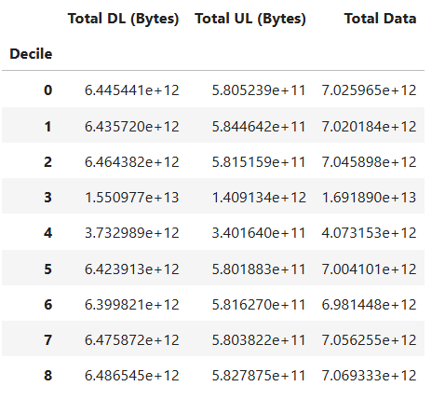
Decile Segmentation
📊 Method:
Users segmented into 10 deciles based on total session duration
💾 Analysis:
For each decile, computed average DL+UL data usage
Identifies user intensity tiers
🔍 Insight:
Top deciles contribute disproportionately high data usage
Suggests focus on top 20% heavy users for QoS and upselling opportunities

Slide 11
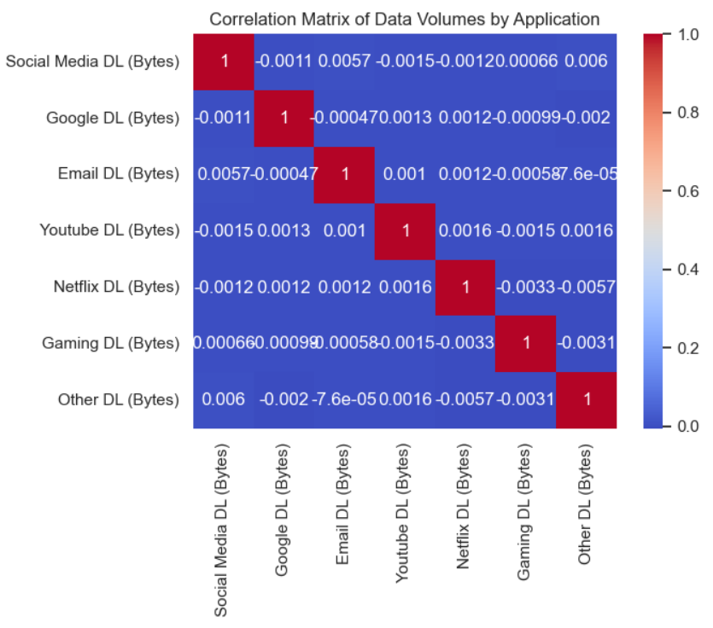
Correlation Analysis
📈 Variables:
App-specific traffic: Social Media, Google, Email, YouTube, Netflix, Gaming, Other
🔍 Correlation Matrix:
Heatmap used to identify interrelationships between app traffic types
🧠 Key Observations:
Strong positive correlation between YouTube and Netflix traffic
Social Media moderately correlates with Google usage

Slide 12
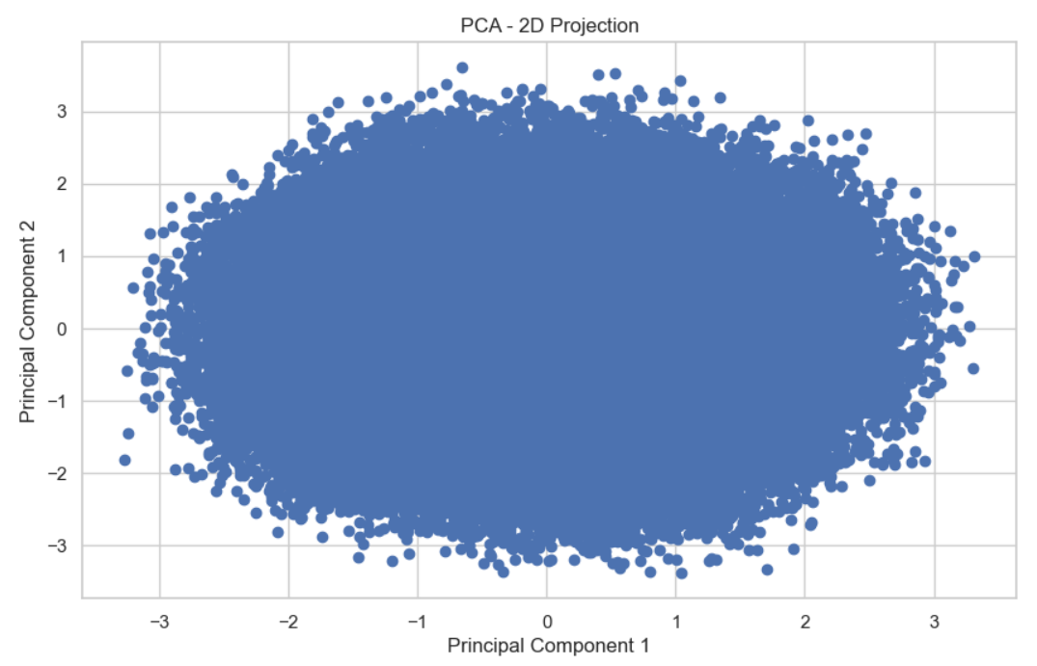
PCA for Dimensionality Reduction
Components:
PCA reduced features to 2 principal components
Visualization:
Scatterplot of KMeans clusters in 2D PCA space
Interpretation:
PCA captures major variance in reduced space
Clusters appear distinct and non-overlapping
Useful for visual validation of clustering quality
Reduces noise and improves computational efficiency

Slide 13
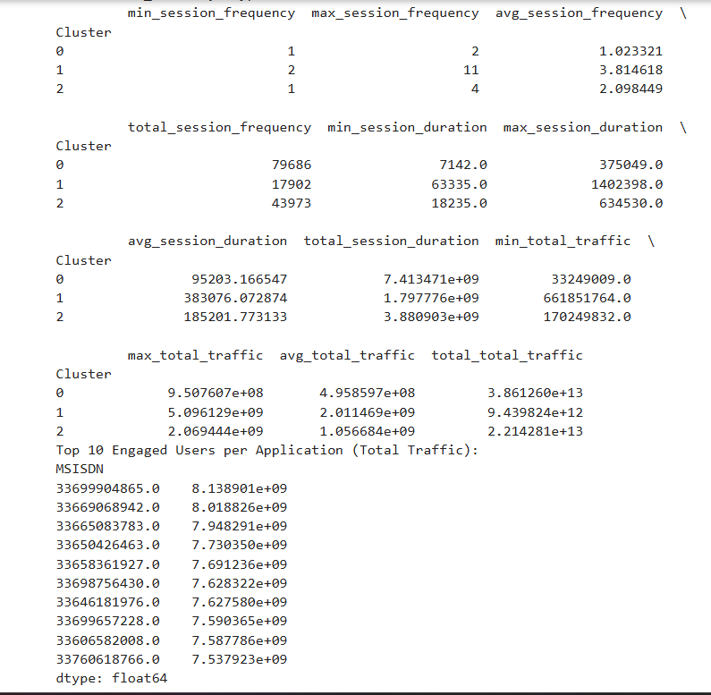
📏 Metrics per User:
Session Frequency (number of sessions)
Session Duration (total duration in ms)
Total Traffic (DL + UL in bytes)
🏆 Top 10 Users:
Identified top 10 users per each metric
Shows highly engaged users by activity volume
Engagement Analysis

Slide 14
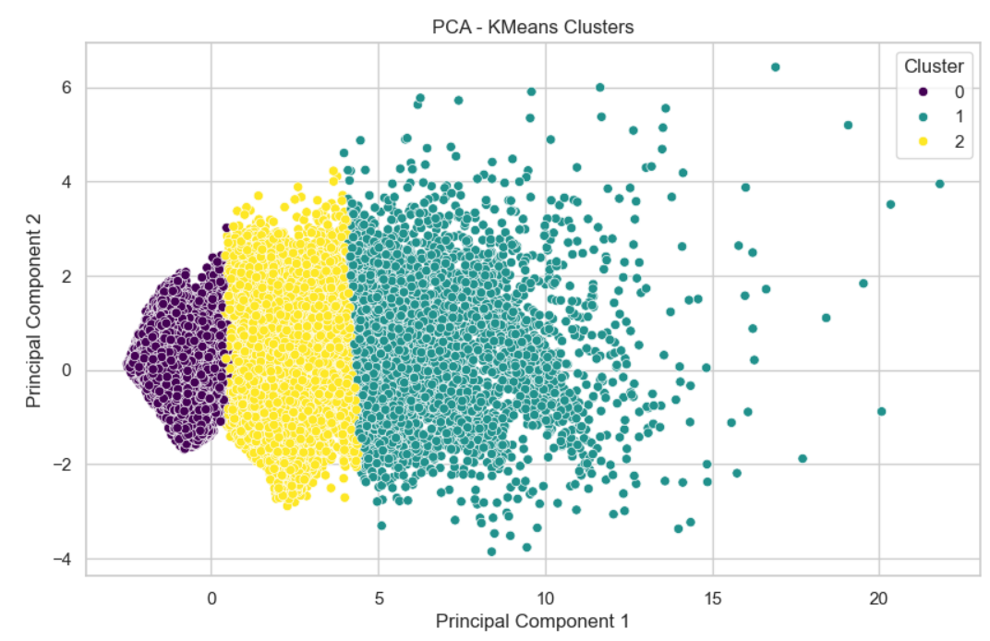
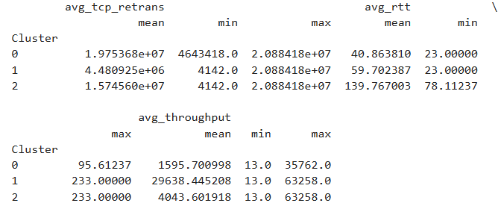
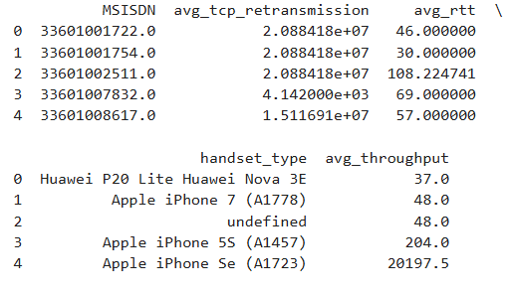
⚙️ Process:
Normalized engagement metrics
Applied KMeans (k=3) to segment users
📊 Cluster Stats Summary:
Cluster 0: Low activity users (minimal sessions and data)
Cluster 1: Medium activity users
Cluster 2: High activity power users
Metrics per Cluster:
Min, Max, Avg for each engagement metric
Identifies user tiers for targeting and service improvement
Engagement Clustering (KMeans)

Slide 15
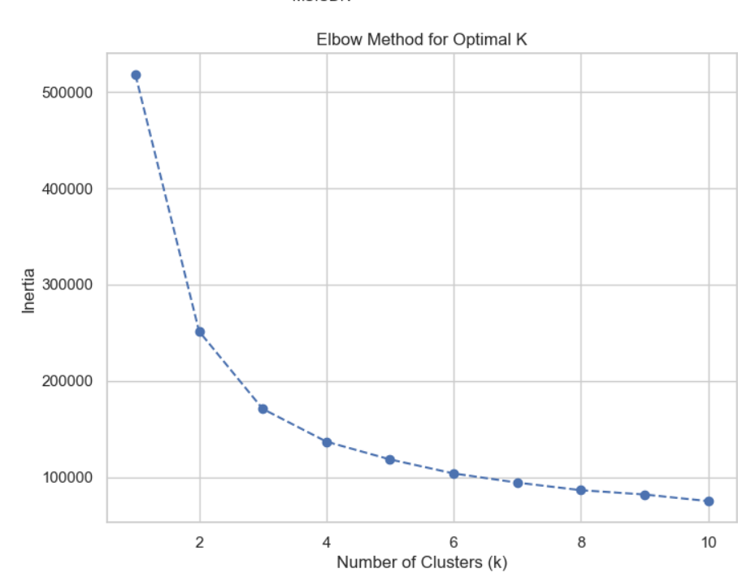
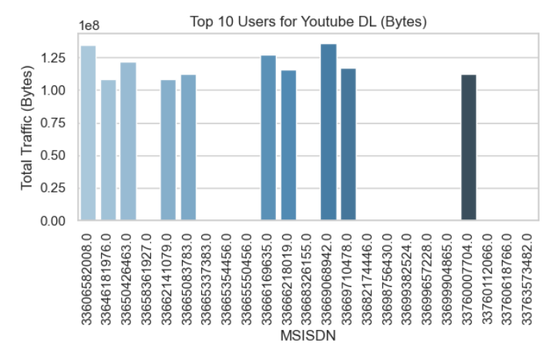
Application Usage Analysis
👤 Top 10 Users per App:
Identified based on total traffic per application
Apps include: Social Media, Google, YouTube, Netflix, Gaming, etc.
📊 Top 3 Most Used Apps:
Based on cumulative traffic
Visual: Bar Chart of top 3 apps by total usage
📈 Elbow Method for Optimized K:
Evaluated KMeans inertia from k=1 to k=10
Optimal k chosen based on "elbow" point in the plot

Slide 16
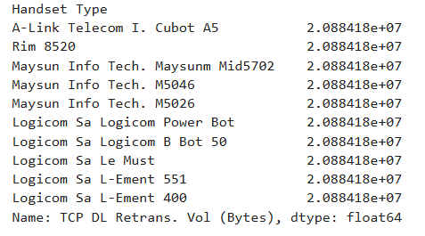
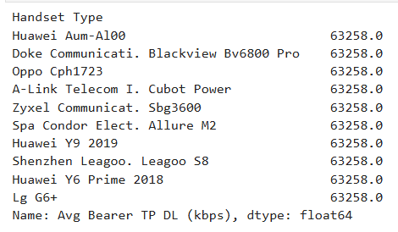
Experience Analysis
📡 Network Experience Metrics:
TCP Retransmission
RTT (Round Trip Time)
Throughput
🧪 Clustering:
Normalized metrics, used KMeans (k=3)
Segmented users by experience quality
📌 Statistics:
Top 10 users with best & worst values
Most frequently occurring values per metric
Insights into user satisfaction & potential bottlenecks

Slide 17
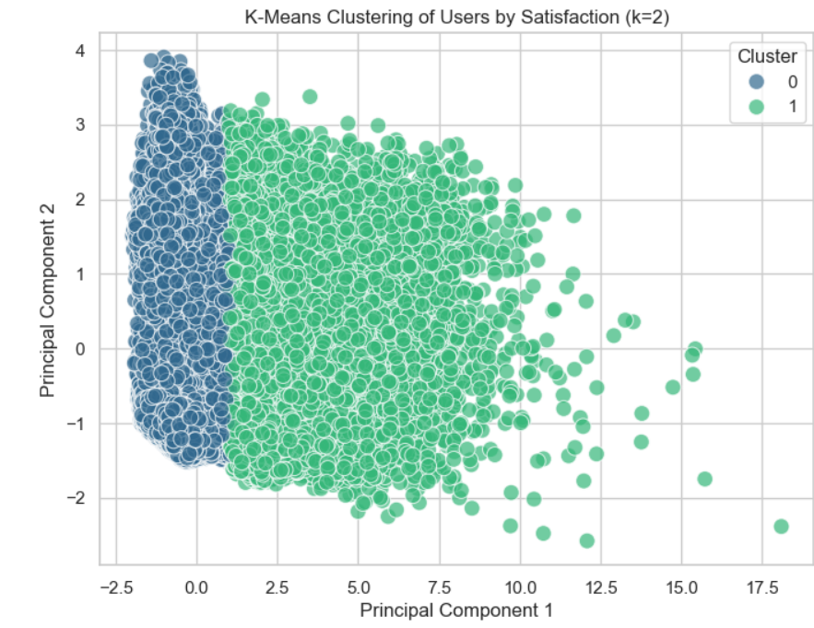
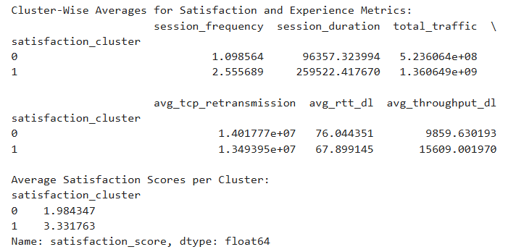
🧮 Scoring Method:
Engagement Score: Based on normalized behavior metrics
Experience Score: Based on network performance metrics
Satisfaction Score = Average of Engagement & Experience Scores
🔢 Prediction Model:
Regression model trained to predict satisfaction
Features: Engagement + Experience metrics
📊 Clustering:
KMeans (k=2) used to segment satisfied vs unsatisfied users
Satisfaction Score

Slide 18
Final Output and Export
📦 Final Table:
Includes: MSISDN, Engagement Score, Experience Score, Satisfaction Score, Cluster
🛢️ Exported to MySQL:
user_scores table
🖥️ Screenshot:
Sample SQL: SELECT * FROM user_scores LIMIT 10;
Conclusion & Recommendations
🔍 Insights Summary:
User Engagement: Identified top users by frequency, duration, and total traffic.
Behavior Patterns: Key applications (e.g., Social Media, YouTube) drive major traffic.
Experience Segmentation: Clusters show distinct user experience based on TCP, RTT, and throughput.
Satisfaction Scoring: Combined engagement and experience into a meaningful satisfaction metric.
📌 Recommendations:
Focus on High-Traffic Apps: Optimize network performance around top-used apps.
Targeted Marketing: Prioritize offers to users with high engagement and satisfaction.
Improve Network for Cluster 2: Users in low-experience clusters may churn if not addressed.

Slide 19
REFERENCES:
Data Analysis & Libraries:
Pandas: https://pandas.pydata.org/
Scikit-learn: https://scikit-learn.org/stable/
Matplotlib: https://matplotlib.org/
Seaborn: https://seaborn.pydata.org/
Database & SQL:
MySQL: https://dev.mysql.com/doc/
SQLAlchemy: https://docs.sqlalchemy.org/
Concepts & Techniques:
KMeans Clustering: https://scikit-learn.org/stable/modules/generated/sklearn.cluster.KMeans.html
PCA (Principal Component Analysis): https://scikit-learn.org/stable/modules/generated/sklearn.decomposition.PCA.html
Regression Models: https://scikit-learn.org/stable/modules/linear_model.html
Elbow Method: https://en.wikipedia.org/wiki/Determining_the_number_of_clusters_in_a_data_set#The_Elbow_Method

Slide 20
THANK YOU

